Slide 1
To Do List Project
Bernard Abraham

Slide 2









Technologies
Describe how these work together, what ones I've used, how I can use them all next time

Slide 3
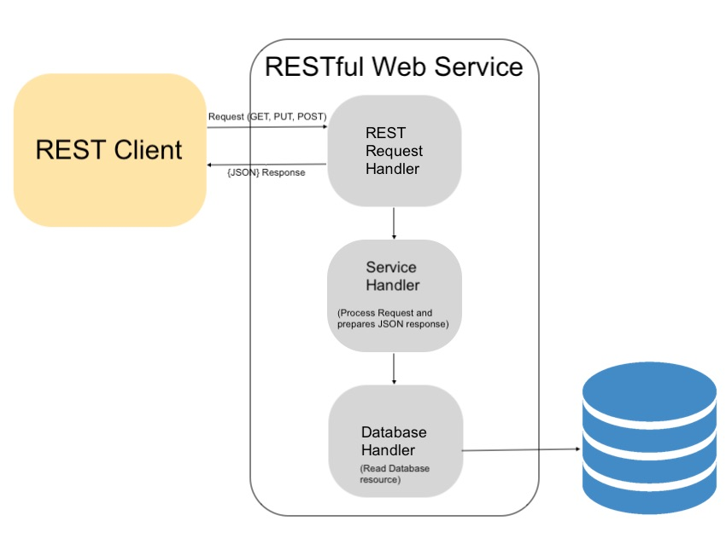
API
Service layer (front-end HTML)
Rest (controller and endpoints)
Logic (services)
Data Access (repository and classes entity manager)
Database - Sql h2

Slide 4
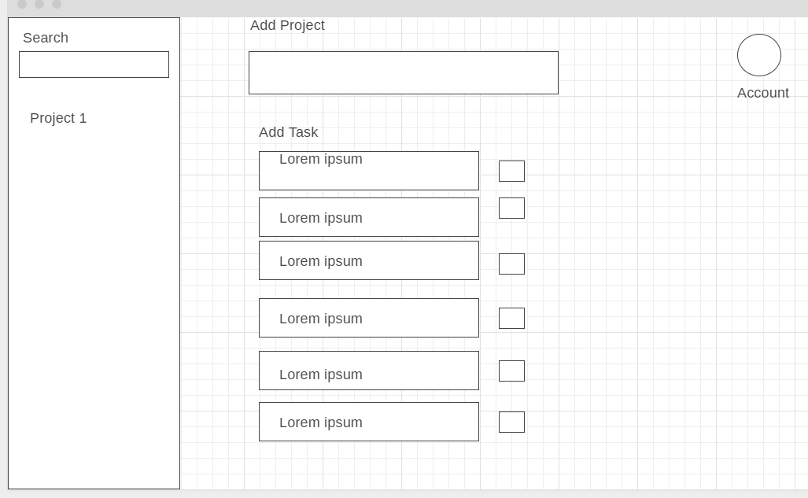
Wireframes
Add tasks as part of a project
Check tasks off
Search Tasks
Manage Account

Slide 5
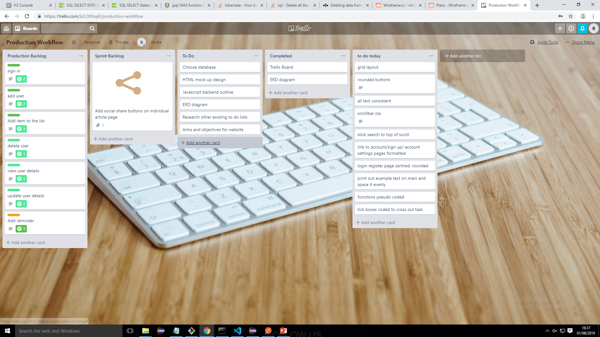
Trello Before

Slide 6
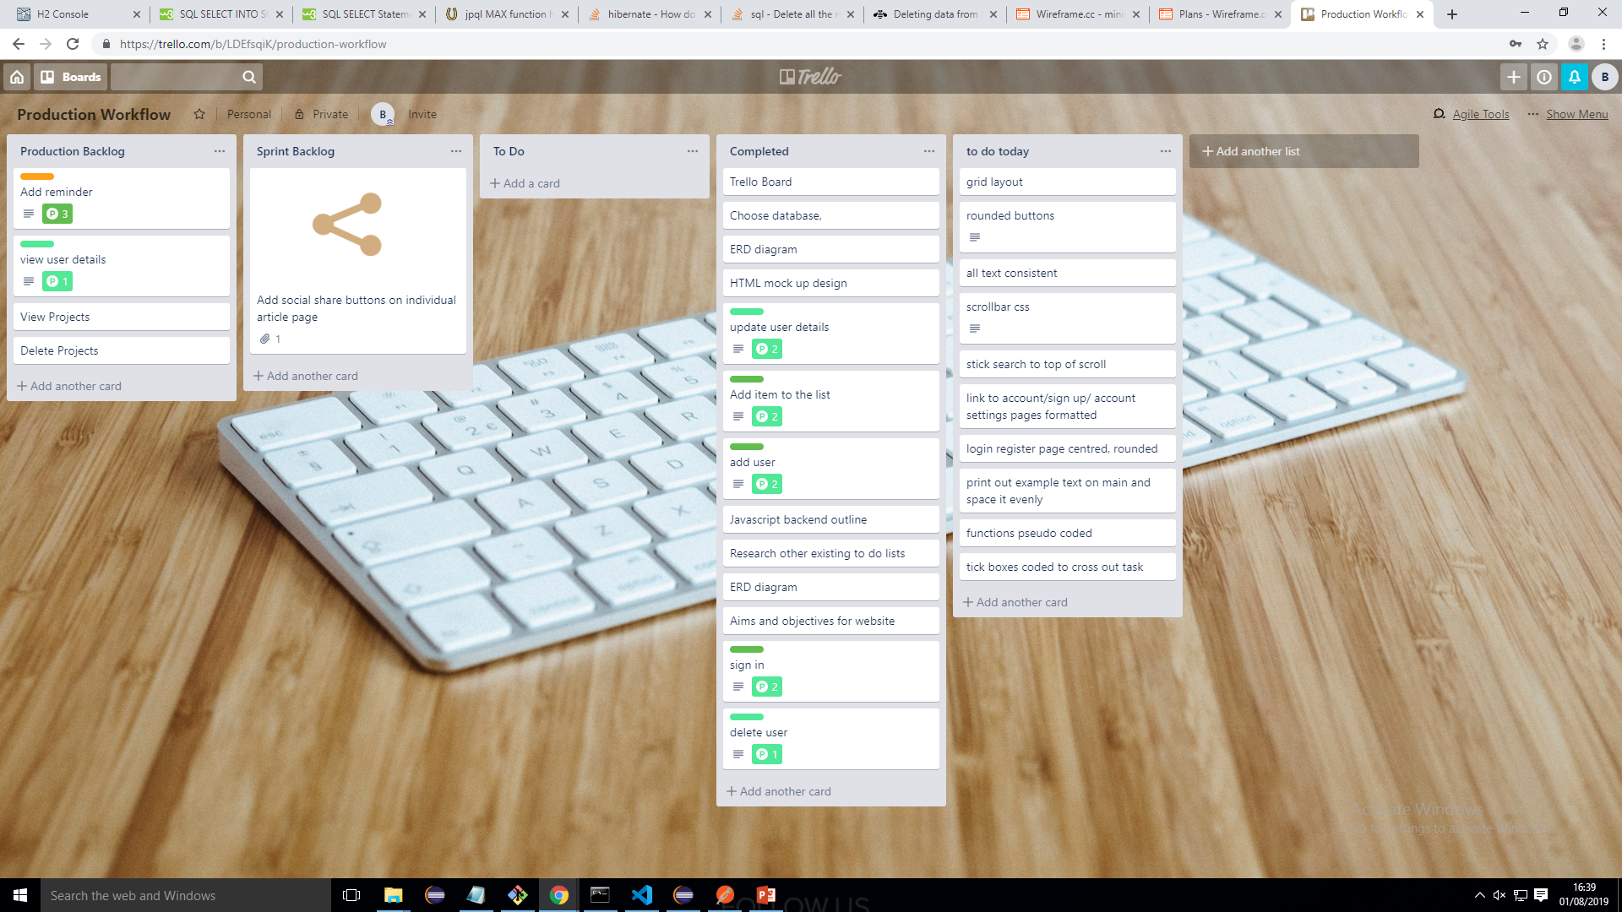
Trello After

Slide 7
Database - Erd Diagram
Task
Task
Project
User
Pkey - TaskId
Pkey - ProjectId
Pkey - UserId
Fkey - ProjectId
Fkey - UserId

Slide 8
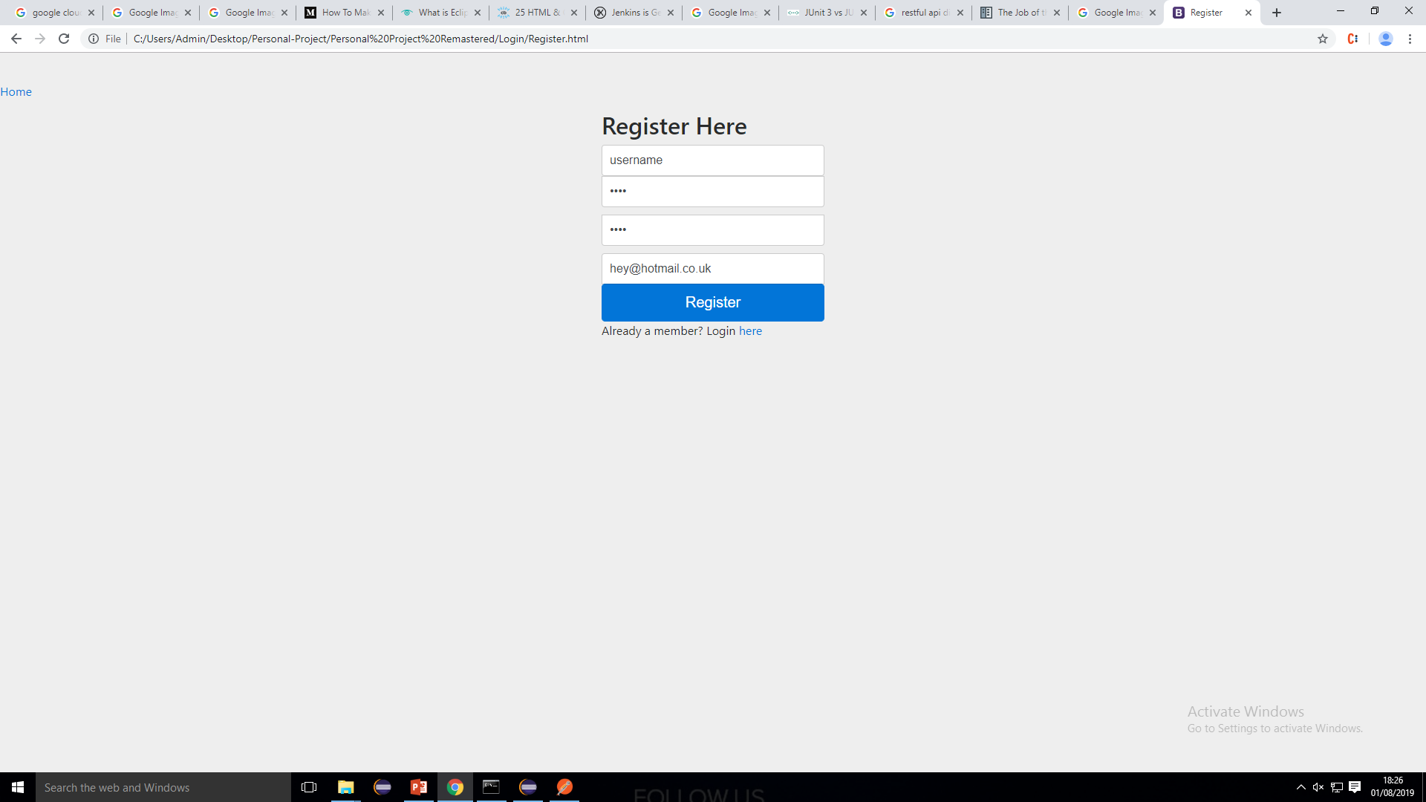

Slide 9
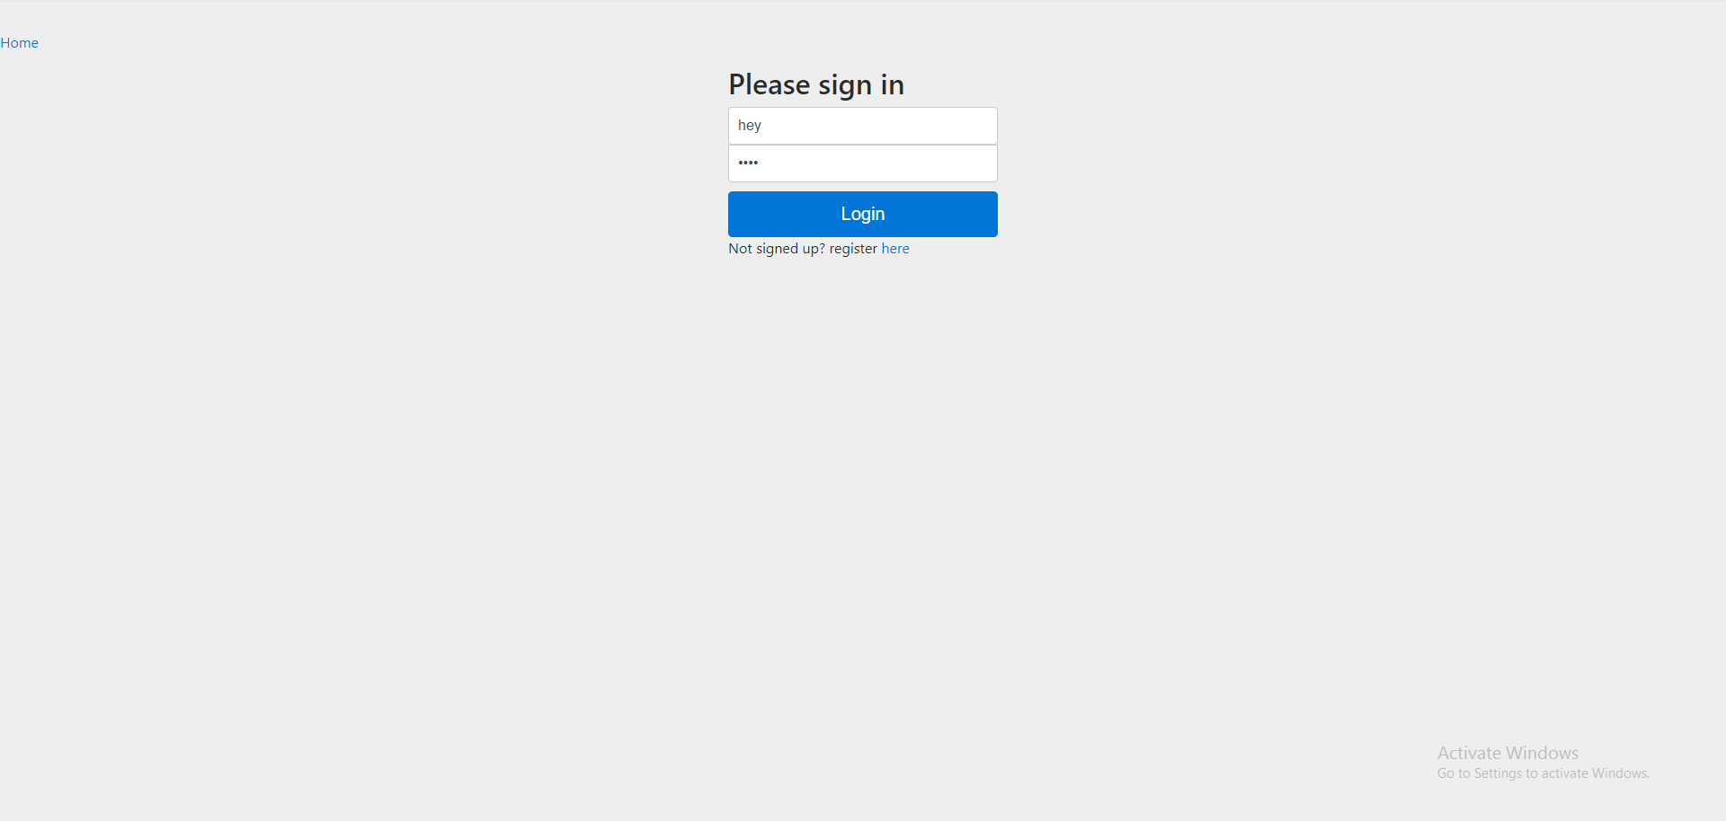

Slide 10
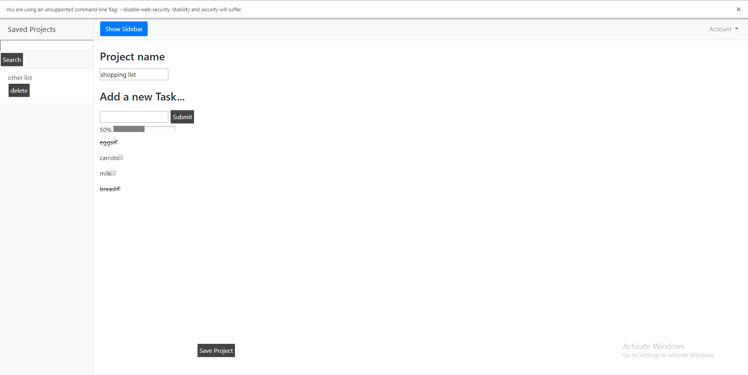

Slide 11
Project Summary
What went well:
3 Tables with Relationships
Multiple pages with good CSS
Login functionality
Extra features
Coding practices (SOLID, self documenting, 4 pillars)
What could be Improved:
Thoughtful planning
Tidier file management

Slide 12
Project Walkthrough
Live demonstration

Slide 13
Thankyou for listening
Questions?

